Slide 1


DATA-DRIVEN INSIGHTS: EXPLORING OPPORTUNITY/ CHALLENGE IN THE INFORMATION AND CULTURAL INDUSTRY
Submitted By(Group 2):
Ashweeni Karmacharya
Bikesh Man Chipalu
Saroj Dhaubanja

Slide 2

AGENDA
Data Collection and Research Methodology
Delving into Analysis
Revealing Results and Insights
Conclusions
Recommendations
Navigating Business Analytics Implications for Manager
Acknowledging Limitations
References

Slide 3

RESEARCH METHODOLOGY AND DATA COLLECTION

Slide 4

PRAGMATIC APPROACH
Quantitative data from Kaggle
- 17 Records after data cleaning and filtering
- Q1 2020 to Q2 2020 (Increase in subscribers)
- Q4 2021 to Q3 2022 (Decrease in subscribers)
2. Qualitative Data from Consumer Affairs and Pissed consumers
- 300 Customer reviews (Q3 2021 to Q2 2022)
- Mostly negative reviews

Slide 5

ANALYSIS, RESULTS AND FINDINGS

Slide 6
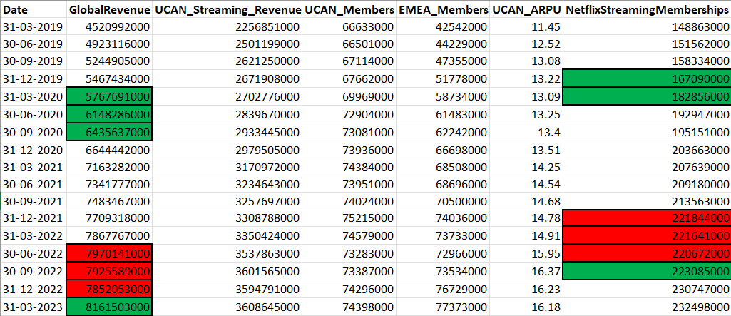
Q2 2020: Notable upswing in subscription numbers accompanied by a significant revenue boost.
Late 2021 - Early 2022: Marked downturn in subscription counts and a noticeable decline in revenue figures.

Slide 7
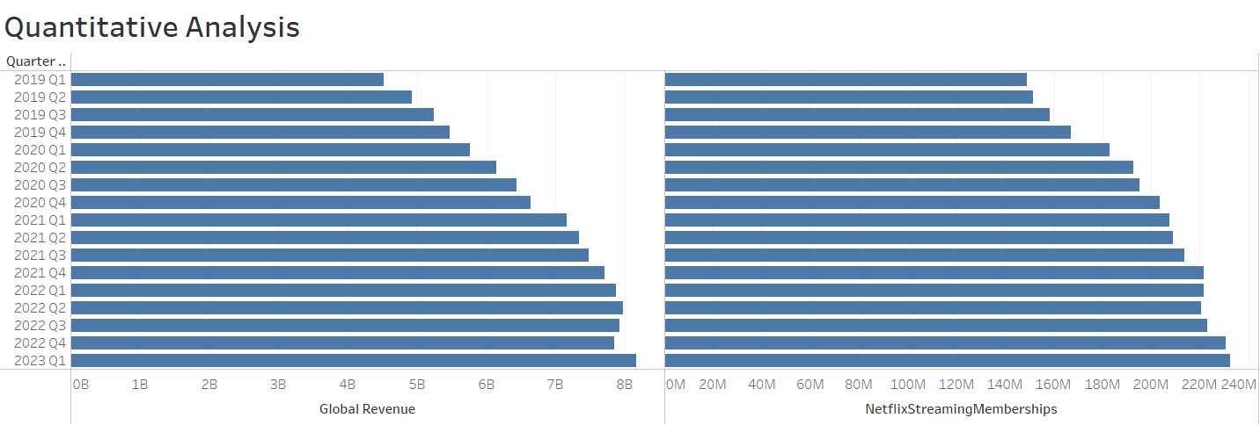
.
Both the graphs show fluctuations during 2020 March (Increase in number of subscriptions and revenue) and during end of 2021 and beginning of 2022 (Decrease in number of subscriptions and revenue)

Slide 8
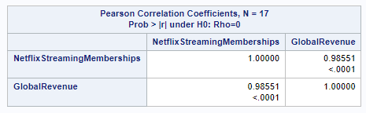
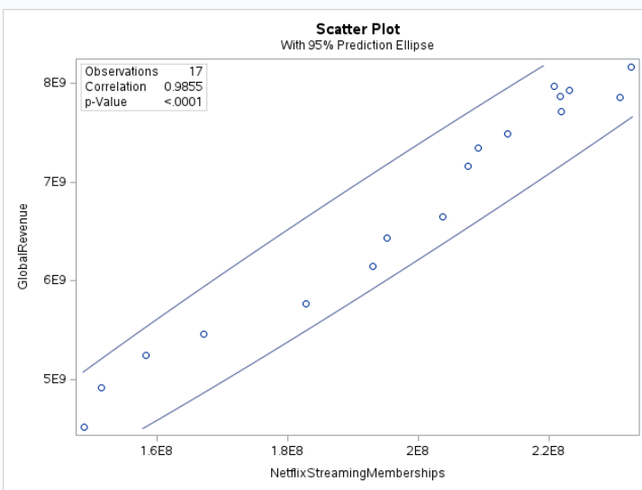
.
Correlation of 0.98551 (Very high positive relation between Subscription and Revenue)
Scatter Plot indicates a strong positive linear relationship between Subscription and Revenue

Slide 9
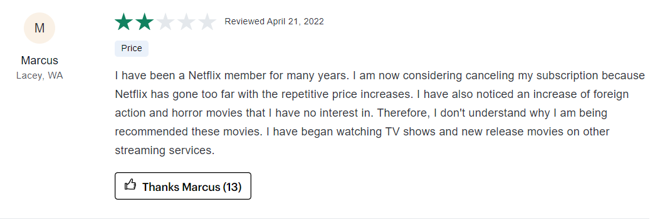
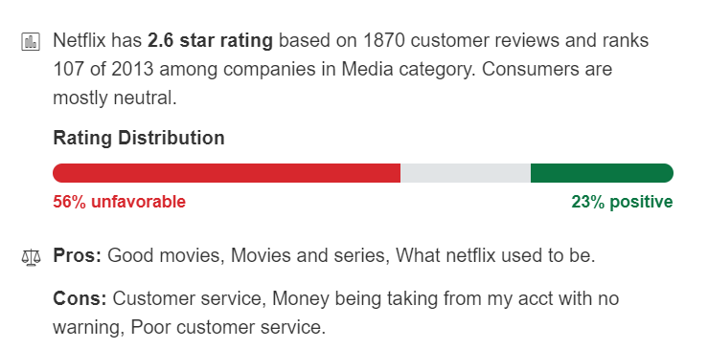
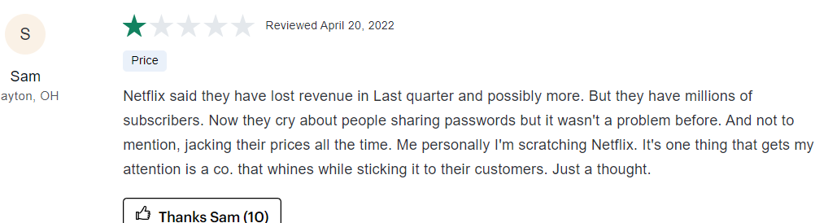
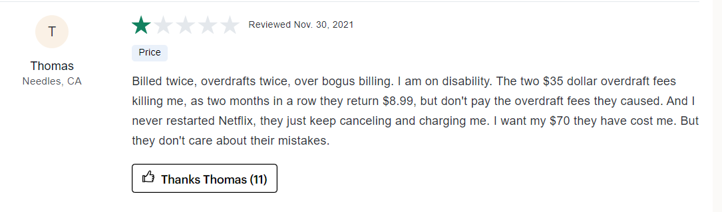
.
From Q3 2021 to Q2 2022, around 300 customer reviews collected.
Predominantly negative feedback, indicating issues with Netflix services.
Resulted in a subscription decline during this timeframe.

Slide 10
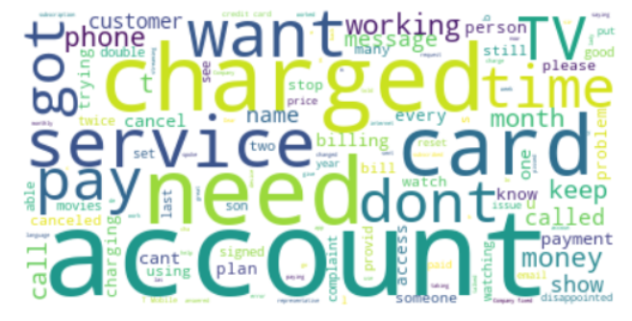
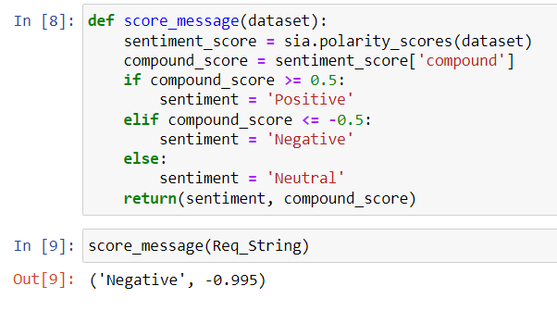
.
Word Cloud Analysis
Most repeated words: "Charged," "service“, "card“, "account“, "payment“, "cancel“, "money“.
Focused on billing and payment-related issues.
Indicates dissatisfaction with account management and financial matters.
Lexicon-Based Analysis
Negative sentiment score of -0.995.
Predominantly negative sentiment expressed.
Reflects widespread dissatisfaction and frustration among subscribers.

Slide 11

Conclusion/Summary
Project Focus: Addressing Netflix's Declined Revenue
Quantitative Data Analysis: Exploring Subscriber and Revenue Trends
Qualitative Data Analysis: Investigating Causes of the Problem
Identified Issue: Declining Revenue Linked to Plummeting Subscribers' base
Root Cause: Poor Customer Service or System Glitches Leading to Overcharging

Slide 12

RECOMMENDATION
Key Challenges Identified:
- Billing and Payment Issues
Customer Service Shortcomings
Strategies for Improvement:
Billing Transparency and Accuracy
Customer Support Enhancement
Service Value and Communication

Slide 13
IMPLICATIONS FOR BUSINESS ANALYTICS MANAGERS
Prioritize monitoring subscriber trends to project revenue accurately and inform strategic decisions effectively.
Data visualization tools is essential for effectively sharing insights and enhancing decision-making understanding.
Consider external influences that affect performance enabling strategy adjustment for better outcomes.
Need to proactively address these fluctuations by understanding customer behavior and implementing strategies using analytic tools.
Should prioritize data quality and alignment with research objectives when selecting datasets for analysis.
Seek to improve approaches, incorporating insights gained from the analysis to enhance decision-making and drive actionable outcomes.
Should adapt the niche marketing strategy.

Slide 14
LIMITATIONS OF THE STUDY
Data Accessibility and Availability
Contextual Information Is Limited

Slide 15
REFERENCES
- (2023, 08 08). (Netflix) Retrieved from consumeraffairs: https://www.consumeraffairs.com/entertainment/netflix.html?page=3#sort=recent&filter=none
- (2023, 06 08). Retrieved from pissedconsumer: https://netflix.pissedconsumer.com/143/RT-P.html#reviews
- MAURYA, S. (2023). Netflix OTT Revenue and Subscribers (CSV File). kaggle. Retrieved from https://www.kaggle.com/datasets/mauryansshivam/netflix-ott-revenue-and-subscribers-csv-file
- Minor, B. M. (2023). Netflix Review. pcmac. Retrieved from https://www.pcmag.com/reviews/netflix
- Sampathkumar, S. (2023). Netflix Business Model – How Much Money Does Netflix Make? vplayed. Retrieved from https://www.vplayed.com/blog/how-does-netflix-make-money/
- Anonymous. "The opportunities and challenges faced by Netflix in a digital world." n.d.
<https://medium.com/digital-society/the-opportunities-and-challenges-faced-by-netflix-in-a[1]digital-world-cd372d3af98c>.
- ARTASHYAN, ARGAM. "EVERYTHING YOU SHOULD KNOW ABOUT NETFLIX
SUBSCRIPTION PLANS AND THE CURRENT SITUATION." 2022.
<https://www.gizchina.com/2022/05/17/everything-you-should-know-about-netflix-subscription[1]plans-and-the-current-situation/>.

